Slide 1

Sequence-to-Sequence and Long Short-Term Memory
Timo Wang

Slide 2
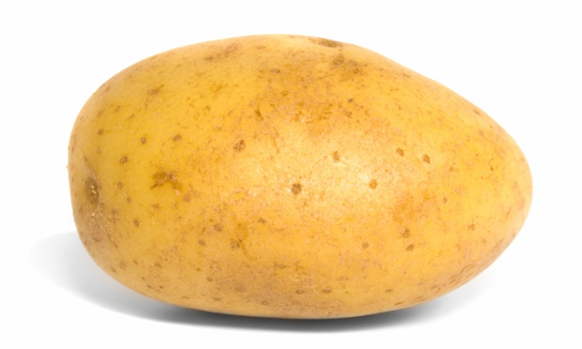
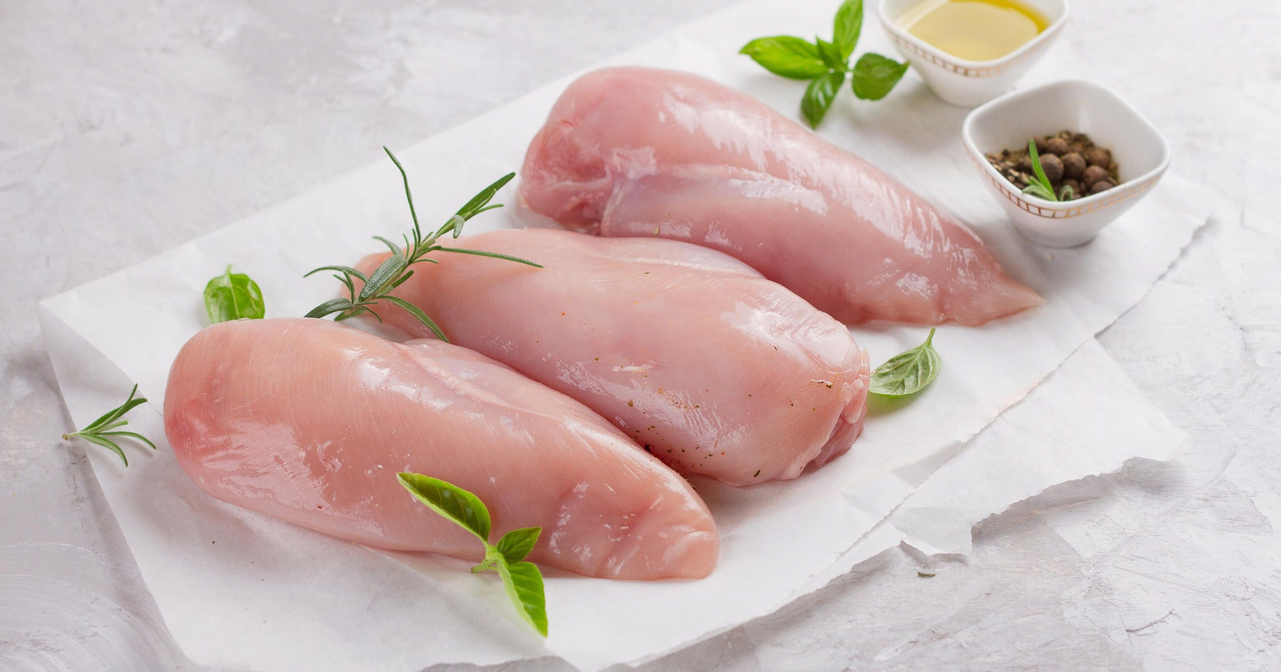

Slide 3
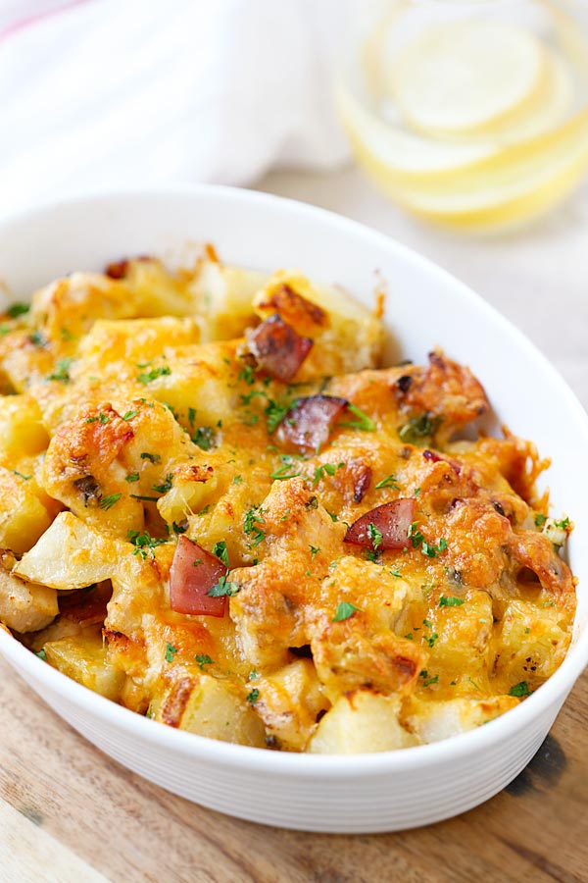

Slide 7
Chopper & Chef
X
Y
Chopper
Chef
Prep Cookware
t=0
t=1
t=2
t=3
t=4
Notes:
Explain how to train an encoder decoder network in the sense how well chopping is done and how well cooking is done.

Slide 8
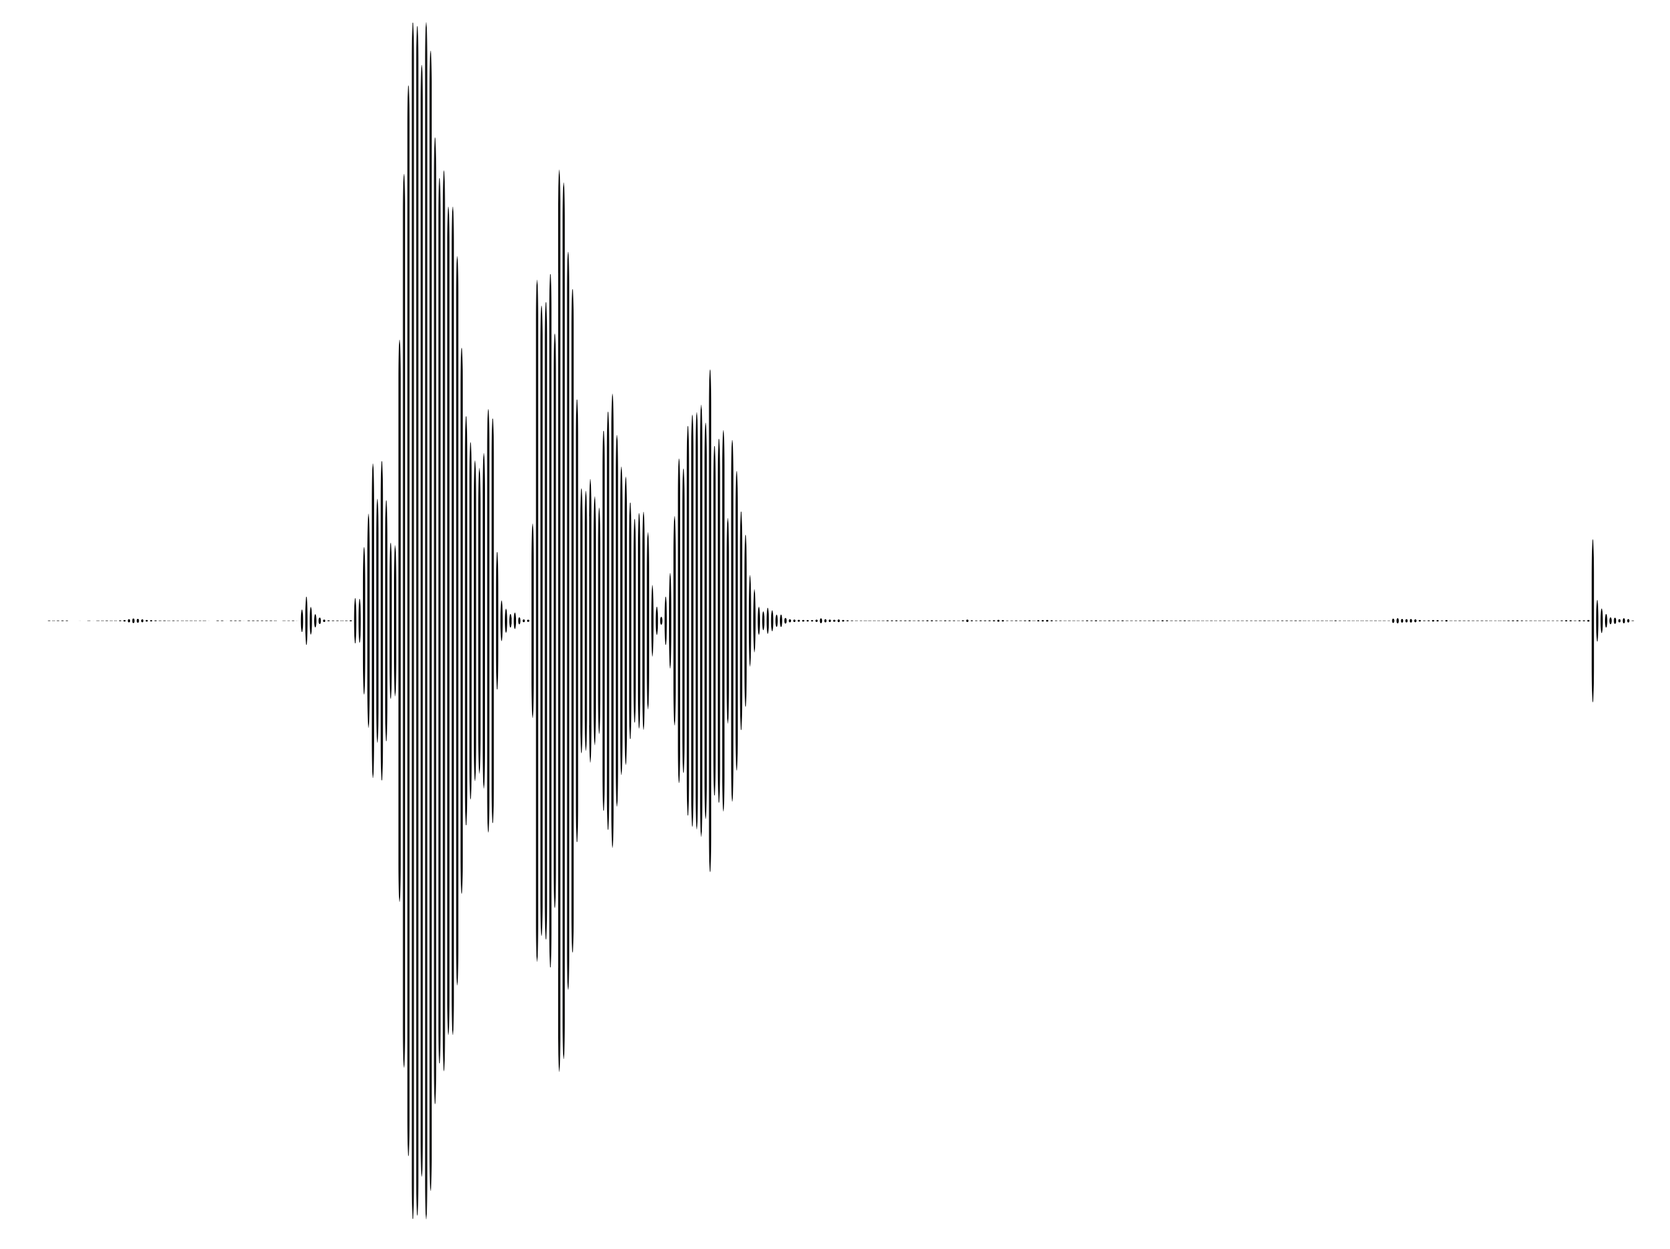
Seq2Seq
X
Y
Chopper
Chef
Translator
How are you
Wie geht’s
Transcriber
How are you

Slide 9
Limitations

Slide 10
Limitations

Slide 11
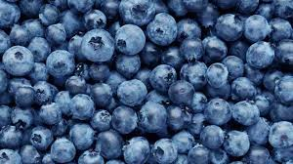
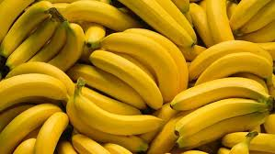
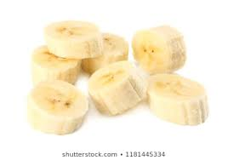
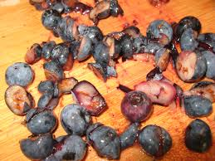
Limitations

Slide 12
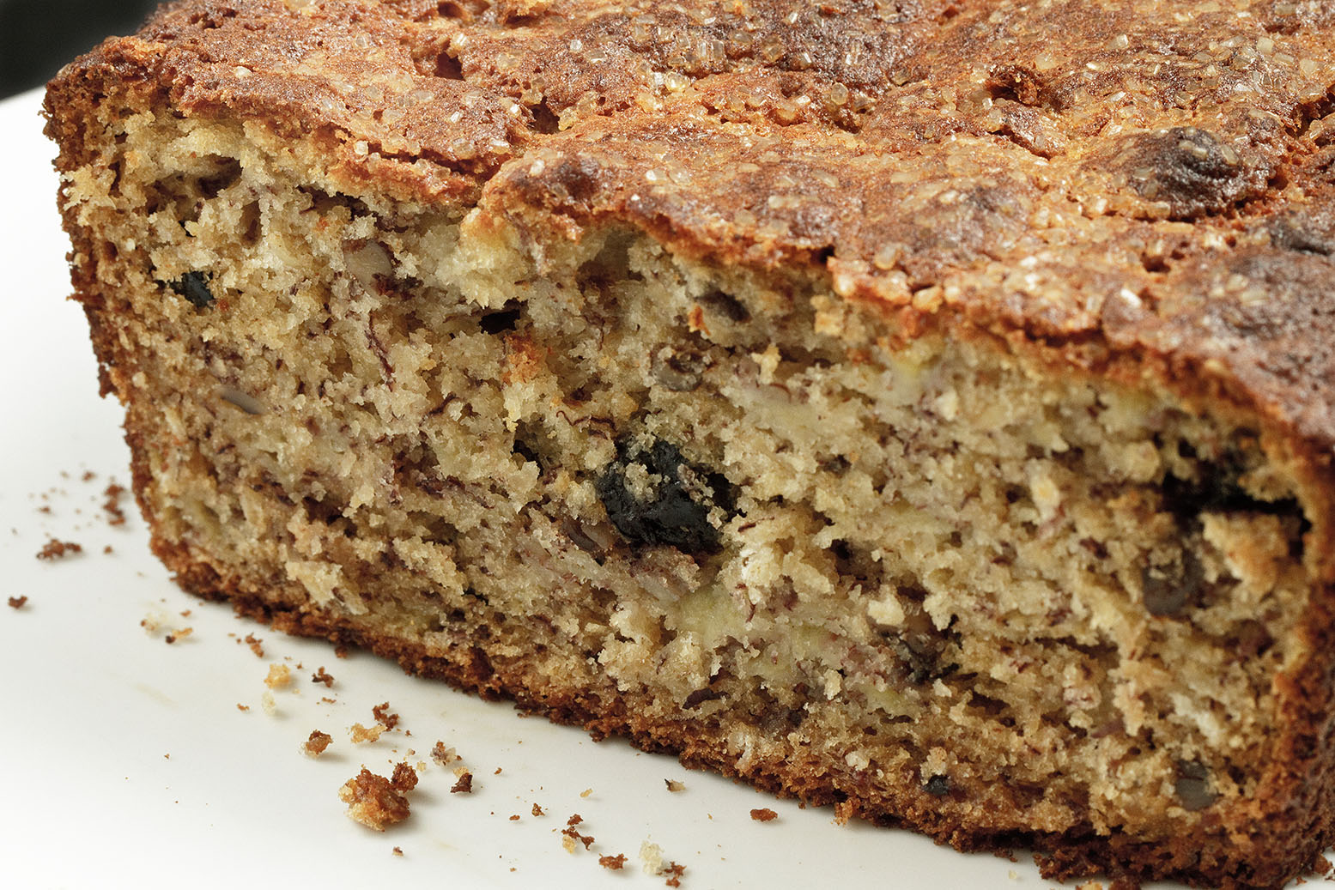
Limitations

Slide 13
Improved Approach

Slide 14
Improved Approach

Slide 15
Improved Approach

Slide 16
Improved Approach

Slide 17
Even Better

Slide 19
Even Better

Slide 20
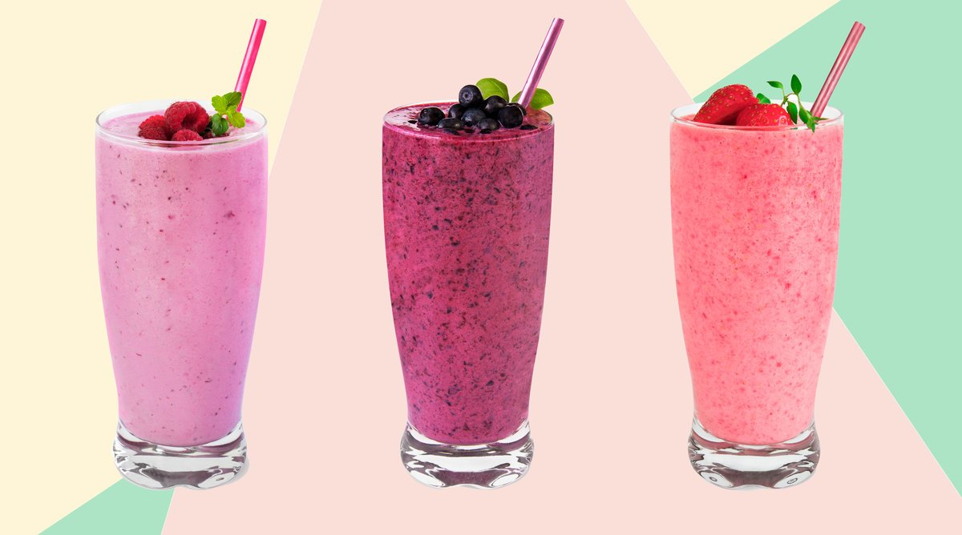

Slide 21
Encoder & Decoder
X
Y
Encoder
Decoder
How
are
you
<EOS>
Wie
geht’s
<EOS>
How
are
you
t=0
t=1
t=2
t=3
t=4
t=5

Slide 22
Limitations
The apple, after being cut into pieces, has turned brown.
The apple, after being cut into pieces, has turned brown.
The apple, after being cut into pieces, has turned brown.

Slide 23
LSTM Concept
The
apple
after
being
cut
has
turned
brown
The
apple
after
being
cut
has
turned
brown
t=0
t=1
t=2
t=3
t=4
t=5
t=6
t=7

Slide 24
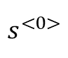
I
arrive
$$s^{<1>}$$
$$s^{<2>}$$
arrive
Step 1
$$e^{<j, i>}=f(s^{<j−1>}, a^{<i>})$$
Step 2
$$w^{<j>}=softmax(e^{<j>})$$
Step 3
$$c^{<j, i>}= \sum_{i=1}^{k}{w^{<j, i>}∗a^{<i>} }$$
c2
$$e^{<2,1>}$$
$$e^{<2,2>}$$
…
$$e^{<2>}$$
Add
…
$$s^{<1>}$$
…
…
…
Attention Score Calculator
Multiply
Multiply
softmax
…
$$a^{<1>}$$
$$a^{<2>}$$
$$w^{<2,1>}$$
$$w^{<2,2>}$$
…
$$w^{<2,1>}$$
$$a^{<1>}$$
$$w^{<2,2>}$$
$$a^{<2>}$$
…
$$w^{<2>}$$
…
Ich
komme
an
I
come
to
Notes:
Better Idea (than seq2seq):
Draw information from the original sentence when translating

Slide 25
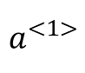
Step 1
I
arrive
$$s^{<1>}$$
$$e^{<2, 1>}$$
Ich
komme
am
Abend
in
München
an
I
come
this
evening
in
Munich
to
ankommen - arrive
Notes:
Better Idea (than seq2seq):
Draw information from the original sentence when translating

Slide 26
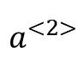
Step 1
I
arrive
$$s^{<1>}$$
$$e^{<2, 2>}$$
Ich
komme
am
Abend
in
München
an
I
come
this
evening
in
Munich
to
ankommen - arrive
Notes:
Better Idea (than seq2seq):
Draw information from the original sentence when translating

Slide 27
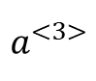
Step 1
I
arrive
$$s^{<1>}$$
$$e^{<2, 3>}$$
Ich
komme
am
Abend
in
München
an
I
come
this
evening
in
Munich
to
ankommen - arrive
Notes:
Better Idea (than seq2seq):
Draw information from the original sentence when translating

Slide 28
Step 1
I
arrive
$$s^{<1>}$$
$$e^{<2, 7>}$$
$$a^{<7>}$$
Ich
komme
am
Abend
in
München
an
I
come
this
evening
in
Munich
to
ankommen - arrive
Notes:
Better Idea (than seq2seq):
Draw information from the original sentence when translating

Slide 29
Step 2
I
arrive
$$s^{<1>}$$
…
$$e^{<2>}$$
Ich
komme
am
Abend
in
München
an
I
come
this
evening
in
Munich
to
ankommen - arrive
Notes:
Better Idea (than seq2seq):
Draw information from the original sentence when translating

Slide 30
Step 2
I
arrive
$$s^{<1>}$$
…
$$e^{<2>}$$
softmax
…
$$w^{<2>}$$
Ich
komme
am
Abend
in
München
an
I
come
this
evening
in
Munich
to
ankommen - arrive
Notes:
Better Idea (than seq2seq):
Draw information from the original sentence when translating

Slide 31
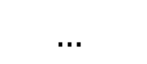
Step 3
I
arrive
$$s^{<1>}$$
…
$$e^{<2>}$$
c2
softmax
Add
Multiply
Multiply
…
$$w^{<2>}$$
$$w^{<2,1>}$$
$$w^{<2,2>}$$
Ich
komme
am
Abend
in
München
an
I
come
this
evening
in
Munich
to
ankommen - arrive
Notes:
Better Idea (than seq2seq):
Draw information from the original sentence when translating

Slide 32
Transformer
Notes:
This model is called transformer, proposed by Google.

Slide 33
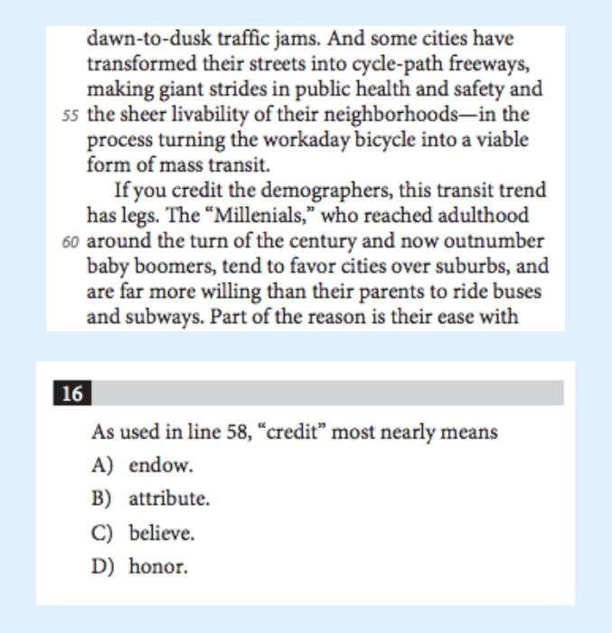
Transformer - Self-Attention
Notes:
The attention mechanism has been discussed before. But the purpose of the discussed attention mechanism is to highlight the useful information in the result of the encoder so that the decoder can most effectively do the translation task. However, in the multi-head attention, there seems to be only one input, either the embeddings of a sentence, or a matrix produced by the previous encoder or decoder layer. It can be confusing. In fact, multi-head attention is built upon a more fundamental variation of attention mechanism, self-attention, which will be discussed next.

Slide 34
Attention
I
arrive
Ich
komme
am
Abend
in
München
an
I
come
this
evening
in
Munich
to
ankommen - arrive
Notes:
Better Idea (than seq2seq):
Draw information from the original sentence when translating

Slide 35
Transformer - Self-Attention
I
really
like
this
apple
I
really
like
this
apple
Notes:
Basically given a sentence, the self attention is helping the computer to understand it word by word. The way it understands a word is to look at all words and find the ones that are most contributive to understanding this word.

Slide 36
I
arrive
$$s^{<1>}$$
$$s^{<2>}$$
arrive
Step 1
Step 2
$$w^{<j>}=softmax(e^{<j>})$$
Step 3
$$c^{<j, i>}= \sum_{i=1}^{k}{w^{<j, i>}∗a^{<i>} }$$
$$e^{<j, i>}=f(s^{<j−1>}, a^{<i>})$$
c2
$$e^{<2,1>}$$
$$e^{<2,2>}$$
…
$$e^{<2>}$$
Add
…
$$s^{<1>}$$
…
…
…
Attention Score Calculator
Multiply
Multiply
softmax
…
$$a^{<1>}$$
$$a^{<2>}$$
$$w^{<2,1>}$$
$$w^{<2,2>}$$
…
$$w^{<2,1>}$$
$$a^{<1>}$$
$$w^{<2,2>}$$
$$a^{<2>}$$
…
$$w^{<2>}$$
…
Ich
komme
an
I
come
to
Notes:
Better Idea (than seq2seq):
Draw information from the original sentence when translating

Slide 37
I
come
arrive
to
I
Ich
komme
an
$$s^{<1>}$$
$$s^{<2>}$$
arrive
$$s^{<2>}$$
Step 1
Step 2
$$w^{<j>}=softmax(e^{<j>})$$
Step 3
$$e^{<j, i>}=f(s^{<j−1>}, a^{<i>})$$
c1
c2
…
c7
$$e^{<2,1>}$$
$$e^{<2,2>}$$
…
$$c^{<j, i>}= \sum_{j=1}^{k}{w^{<j, i>}∗a^{<i>} }$$
$$e^{<2>}$$
Add
…
…
…
…
Attention Score Calculator
Multiply
Multiply
softmax
…
$$a^{<1>}$$
$$a^{<2>}$$
$$w^{<2,1>}$$
$$w^{<2,2>}$$
…
$$w^{<2,1>}$$
$$a^{<1>}$$
$$w^{<2,2>}$$
$$a^{<2>}$$
…
$$w^{<2>}$$
…
Ich
komme
an
I
come
to
Notes:
Better Idea (than seq2seq):
Draw information from the original sentence when translating

Slide 38
Masked Self-Attention
I arrive __ __
I
arrive
__
__

Slide 39
I
come
arrive
to
I
Ich
komme
an
$$s^{<1>}$$
$$s^{<2>}$$
arrive
$$s^{<2>}$$
Step 1
Step 2
$$w^{<j>}=softmax(e^{<j>})$$
Step 3
$$e^{<j, i>}=f(s^{<j−1>}, a^{<i>})$$
c1
c2
…
c7
$$e^{<2,1>}$$
$$e^{<2,2>}$$
…
$$c^{<j, i>}= \sum_{j=1}^{k}{w^{<j, i>}∗a^{<j>} }$$
$$e^{<2>}$$
Add
…
…
…
…
Attention Score Calculator
Multiply
Multiply
softmax
…
$$a^{<1>}$$
$$a^{<2>}$$
$$w^{<2,1>}$$
$$w^{<2,2>}$$
…
$$w^{<2,1>}$$
$$a^{<1>}$$
$$w^{<2,2>}$$
$$a^{<2>}$$
…
$$w^{<2>}$$
…
Ich
komme
am
an
I
come
this
to
Notes:
Better Idea (than seq2seq):
Draw information from the original sentence when translating

Slide 40
I
come
arrive
to
I
Ich
komme
an
$$s^{<1>}$$
$$s^{<2>}$$
arrive
$$s^{<2>}$$
Step 1
Step 2
$$w^{<j>}=softmax(e^{<j>})$$
Step 3
$$e^{<j, i>}=f(s^{<j−1>}, a^{<i>})$$
c1
c2
…
c7
$$e^{<2,1>}$$
$$e^{<2,2>}$$
…
$$c^{<j, i>}= \sum_{j=1}^{k}{w^{<j, i>}∗a^{<j>} }$$
$$e^{<2>}$$
Add
…
…
…
…
Attention Score Calculator
Multiply
Multiply
softmax
…
$$a^{<1>}$$
$$a^{<2>}$$
$$w^{<2,1>}$$
$$w^{<2,2>}$$
…
$$w^{<2,1>}$$
$$a^{<1>}$$
$$w^{<2,2>}$$
$$a^{<2>}$$
…
$$w^{<2>}$$
…
Ich
komme
am
an
I
come
this
to
Notes:
Better Idea (than seq2seq):
Draw information from the original sentence when translating

Slide 41
Seq2Seq
X
Y
Encoder
Decoder
Translator
How are you
Wie geht’s
Captioner
A cat laughts

Slide 42
Experiment Analysis
Notes:
This model is called transformer, proposed by Google.

Slide 43
Experiment Analysis
Qualitative
Quantitative
Visualization:
Hypertools
MatplotLib
BertViz
Explain how your model differs from others
Explain if your experiments verify your hypothesis
Explain the numerical results such as analyze why some error occurs
Compute a score with a set of suitable metrics:
BLEU for machine translation
ROUGE for summarization
Compare your results with SOTAs (using a table)
Present experiment-specific statistics using figures such as charts
Be as specific with numbers as possible and use them to back up your verification of hypothesis

